Slide 1
Motivation

Slide 2
Motivation
Motivation is the process that accounts for the intensity, direction, and persistence of effort that an individual exhibits towards obtaining goals
More specifically:
Intensity: How much effort will an employee exert towards a particular goal in his/her job?
Direction: Which goals, or aspects of the goals, will an employee exert effort towards?
Persistence: How long will an employee exert effort?
LECTURE 5: Needs ∙ Process Theories ∙ Job Design

Slide 3
Motivation
Intrinsic motivation arises when an individual takes action solely for the enjoyment and meaning inherent in the action itself
Extrinsic motivation arises when an individual takes action in order to acquire rewards or resources from the external environment
Studies find intrinsic motivation leads to higher quality work, and extrinsic to higher quantity
(Cerasoli, Nicklin, & Ford, 2014)
LECTURE 5: Needs ∙ Process Theories ∙ Job Design

Slide 4
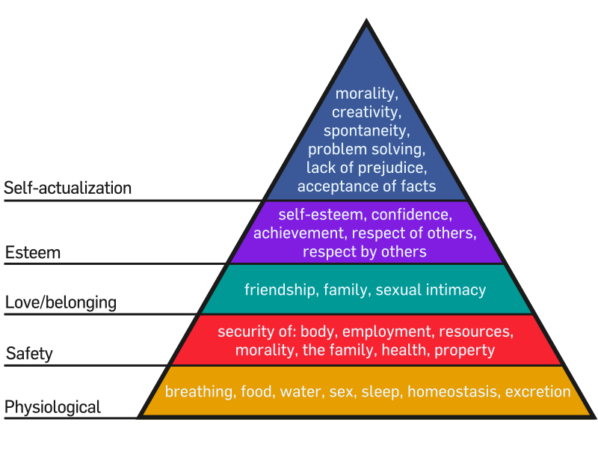
General Needs
Maslow’s Need Hierarchy
When a need is lacking, people are motivated to take action that fulfills it
LECTURE 5: Needs ∙ Process Theories ∙ Job Design

Slide 5
General Needs
There are three major expansions on Maslow’s Needs Hierarchy:
Need fulfillment is also regressive (go to lower order needs when unable to meet higher order ones)
Hierarchy has a cultural bias
Higher level needs can still be motivators even if lower one’s are not met
LECTURE 5: Needs ∙ Process Theories ∙ Job Design

Slide 6
Acquired Need Tendencies
Building off of Maslow, McClelland theorized and found evidence suggesting that people acquire trait-like need tendencies, which are:
Needs or desires that are learned or acquired over time, yet also describe a “style” or tendency of motivation (similar to traits or personality)
LECTURE 5: Needs ∙ Process Theories ∙ Job Design

Slide 7
Acquired Need Tendencies
Need for Achievement: Seek performance excellence, enjoy difficult and challenging goals
Need for Power: Seeks to exert emotional and behavioral control or influence over others
Need for Affiliation: Seeks to establish and maintain warm, close, and intimate relationships with others
LECTURE 5: Needs ∙ Process Theories ∙ Job Design

Slide 8
Acquired Need Tendencies
Need for Achievement: Entrepreneurs and managers typically have high NAch; linked to career success
Need for Power: Managers, executives, and leaders tend to perform better if they have a high NPow
Need for Affiliation: Found in jobs requiring social interaction; great “team players” and provide emotional support
LECTURE 5: Needs ∙ Process Theories ∙ Job Design

Slide 9
Fundamental Needs
Self-determination theory finds that people are more intrinsically motivated to do things that help them meet three fundamental human needs: autonomy, competence, and relatedness
(Deci & Ryan, 2010; Ryan & Deci, 2000)
Although extrinsic motivators usually reduce intrinsic motivation, fulfillment of those three needs while performing a task can encourage workers to internalize external standards
(e.g., Deci, Eghrari, Patrick, & Leone, 1994; Gagne & Deci, 2005; Ryan & Deci, 2000)
LECTURE 5: Needs ∙ Process Theories ∙ Job Design
Notes:
Whereas Maslow’s hierarchy is used mainly with need fulfillment as an ends, SDT sees need fulfillment as a means. To the extent that the performance of a particular task fulfills any of the three fundamental needs, a person’s innate propensity for growth and expansion will be facilitated, rather than inhibited. This may indeed help them more effectively fulfill their Maslow needs, especially self-actualization.
The catch is, that need fulfillment only works to the extent that a person finds that task interesting and novel (i.e., is intrinsically motivated to complete it) in the first place. Since not all employees are intrinsically motivated to do their tasks, need fulfillment often has to be leveraged to facilitate the internalization of external standards or values

Slide 10
Fundamental Needs
What are some workplace events that can fulfill each of the three need tendencies?
Autonomy
Increased control over one’s decisions, adequate resources, acknowledgement of one’s personal feelings/thoughts, cooperatively set goals and deadlines, no threats
Competence
Feedback about one’s effectiveness, rewards for competence rather than solely for outcomes, recognition of skill and performance
Relatedness
Identifying with others and feeling similar to them, personally supportive communication, helping someone else and vice-versa
LECTURE 5: Needs ∙ Process Theories ∙ Job Design
Notes:
A new study in England argues that motivational awards given to children, such as points, stickers, and treats, have little effect on performance.
They may reduce “intrinsic motivation.” Rather than doing a task for its own sake, they do it just for the reward.

Slide 11
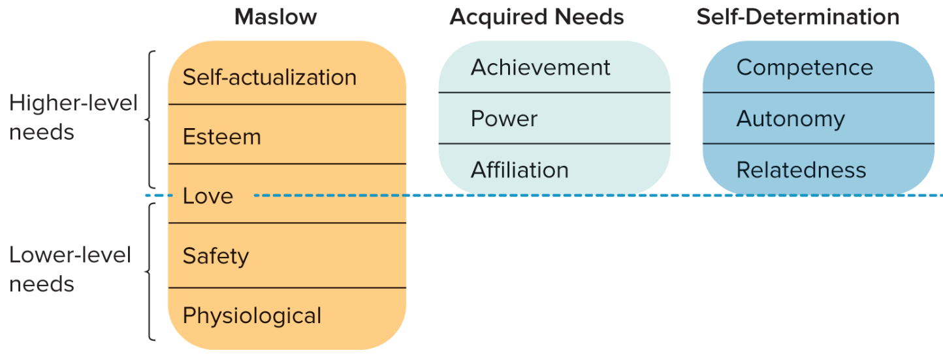
Needs
LECTURE 5: Needs ∙ Process Theories ∙ Job Design
Notes:
13
10

Slide 12
Needs
Linking these models together:
Lower-order needs (physiological, security) must be satisfied before a person is motivated to fulfill…
Higher-order needs (autonomy, relatedness, competence), each of which may be more or less salient/meaningful for a person based on his/her…
Trait-like need tendencies (achievement, power, affiliation)
LECTURE 5: Needs ∙ Process Theories ∙ Job Design

Slide 13
Engagement
When intrinsically motivated and the context supports need fulfillment, workers often become engaged in their work; engagement is a persistent and positive affective-motivational state
Engagement is strongly linked to job performance and reduced stress and burnout, yet is most effective when matched with recovery events (e.g., breaks, vacations, etc.)
LECTURE 5: Needs ∙ Process Theories ∙ Job Design
Notes:
A new study in England argues that motivational awards given to children, such as points, stickers, and treats, have little effect on performance.
They may reduce “intrinsic motivation.” Rather than doing a task for its own sake, they do it just for the reward.

Slide 14
Engagement
Work engagement is seen as the opposite from burnout and exhaustion; it is a persistent, positive, affective-motivational state of fulfillment
Individuals express themselves physically, emotionally, and mentally through their work… feel connected and able to handle job demands
Stresses the importance of energy recovery (e.g., vacations, positive activities, leisure, etc.)
LECTURE 5: Needs ∙ Process Theories ∙ Job Design

Slide 15
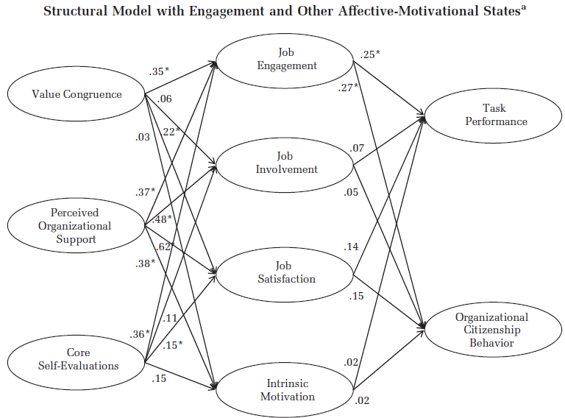
Engagement
From a recent study involving 245 firefighters:
LECTURE 5: Needs ∙ Process Theories ∙ Job Design

Slide 16
Process Theories: Equity
Workers will only be motivated to fulfill their needs under certain conditions; these conditions are dictated by social and organizational processes
First, organizations are built on social exchanges between people; according to equity theory, people are motivated based on their perceptions of the fairness of those exchanges
LECTURE 5: Needs ∙ Process Theories ∙ Job Design
Notes:
Organizations are built on social exchange, which involves demands and contributions between it and its employees
People compare their input/output ratio to that of a referent, which can be another person, an expectation held by the individual, or past experience regarding what input leads to what outcome

Slide 17
Process Theories: Equity
When they perceive inequity in comparison to a referent, people experience tension and are motivated to relieve that tension by bringing the input/outcome ratios back into balance
LECTURE 5: Needs ∙ Process Theories ∙ Job Design

Slide 18
Process Theories: Equity
There are five major ways to restore equity:
Change inputs or outcomes
Change referents’ inputs or outcomes
Change perceptions of input/outcome ratios for self or referent (e.g., rationalization)
Change the referent
Leave the organization (turnover)
LECTURE 5: Needs ∙ Process Theories ∙ Job Design

Slide 19
Process Theories: Expectancy
Expectancy theory explains how employees make choices among alternative behaviors and levels of effort they will exert towards a task or goal
Two general assumptions:
Performing at a certain level will lead to a certain outcomes
Effort will lead to a certain level of performance
LECTURE 5: Needs ∙ Process Theories ∙ Job Design

Slide 20
Process Theories: Expectancy
Three key components of expectancy theory:
Valence: Value/importance a person places on a certain reward
Instrumentality: Extent to which a person believes performance of certain behaviors will lead to a certain reward
Expectancy: Extent to which a person believes effort will lead to a certain level of performance
LECTURE 5: Needs ∙ Process Theories ∙ Job Design

Slide 21
Process Theories: Expectancy
The level of motivation depends on the level of valence, instrumentality, and expectancy perceived by an employee
If any one of those three components is zero, then motivation will be zero
LECTURE 5: Needs ∙ Process Theories ∙ Job Design

Slide 22
Process Theories: Expectancy
Expectancy
“Will effort actually lead to performance?”
Instrumentality
“If I perform, will I receive a certain outcome?”
Valence
“How much do I want this outcome?”
Effort
Performance
Outcome
LECTURE 5: Needs ∙ Process Theories ∙ Job Design

Slide 23
Process Theories: Expectancy
How can managers fix these three problems?
Lack of expectancy?
Boost self-efficacy, skills training/development
Lack of instrumentality?
Ensure behaviors are rewarded, pay-for-performance, recognize/monitor performance, explain linkage
Lack of valence?
Alter the reward, illustrate the valence of the reward
LECTURE 5: Needs ∙ Process Theories ∙ Job Design

Slide 24
Job Design
The scientific management approach emphasized standardizing jobs and explicitly specifying task activities employees will perform; it reduced the need to think/deliberate about the job
What are the benefits?
Easily understood tasks, shared perspective, minimizes psychomotor error
What are the limitations?
Boring, not optimal performance, no creativity
LECTURE 5: Needs ∙ Process Theories ∙ Job Design
Notes:
Scientific management was a great start. It greatly enhanced the integration of employee and supervisor, where the supervisor was now more responsible for helping the employee perform the job (e.g., having job knowledge, removing roadblocks, being on the “same team”). Unfortunately, even with jobs like this, people can still become DISTRACTED

Slide 25
Job Design
Later models, such as the job characteristics model, found that simplicity isn’t always the most effective way to motivate people
Job characteristics model finds that different core dimensions of a job will lead to psychological states that then impact personal/work outcomes
LECTURE 5: Needs ∙ Process Theories ∙ Job Design

Slide 26
Job Design
Job characteristics model:
LECTURE 5: Needs ∙ Process Theories ∙ Job Design
Notes:
In addition to high GNS, short job tenure (e.g., new employees), high satisfaction with work and co-workers, and self-actualization can enhance the impact of high MPS jobs on outcomes
Most research finds that perceived job characteristics have a greater impact on outcomes than objective characteristics

Slide 27
Job Design
Job enlargement increases the number of tasks and responsibilities of a given job
Job rotation periodically moves workers between specialized tasks; typically used to enhance employee flexibility, but may also enhance motivation
Enlargement and rotation are linked to increased performance quality and leader-member communication
LECTURE 5: Needs ∙ Process Theories ∙ Job Design
Notes:
There are three primary methods used to enhance the motivating potential of a job

Slide 28
Job Design
Job enrichment involves increasing the number, variety, and challenge of tasks, but also increasing authority and structuring tasks as whole units; heightening autonomy is usually required to successfully enrich a job
Job enrichment is useful and can enhance the meaningfulness of an employee’s job, assuming the employee is capable of adapting to such changes
LECTURE 5: Needs ∙ Process Theories ∙ Job Design

Slide 29
Job Design
Sample job re-design techniques include: Forming logical work units, close client relationships, delegation, opening feedback channels
Altering job characteristics will only have an effect on employees if they are open to the possibility of change in their job, which can be influenced by personality, job satisfaction, tenure, goals, etc.
LECTURE 5: Needs ∙ Process Theories ∙ Job Design

Slide 30
Job Design
Recent work in the last 2000s and early 2010s have focused more heavily on autonomy and feedback, and also found that they work best when complemented with social support and opportunities to learn and to develop
Studies have found that the above four job resources enhance employee engagement and reduce employee burnout (to a lesser extent)
(Bakker & Demerouti, 2008; Hakanen, Schaufeli, & Ahola, 2008; Nahrgang, Morgeson, & Hofmann, 2010; Schaufeli, Bakker, & Van Rhenen, 2009)
LECTURE 5: Needs ∙ Process Theories ∙ Job Design

